Slide 1
Exponential Functions
By your friendly neighbourhood Mathematics teachers

Slide 2
Fermi Questions
What number do you get if you multiply all the numbers of your mobile number?
A man picks up cigarette butts from the ground and can make a cigarette with 4 butts. If he finds 16 cigarette butts, how many cigarettes can he make?
On a clock, how many times a day do the minute and hour hand overlap?

Slide 3
Answers: How did you go?
Answer: 0
Answer: 5. He makes 4 cigarettes with the 16 butts. Then he smokes them and has 4 more butts to make another cigarette.
Answer: 22 times: 12:00:00, 1:05:27, 2:10:55, 3:16:22, 4:21:49, 5:27:16, 6:32:44, 7:38:11, 8:43:38, 9:49:05, 10:54:33.

Slide 4
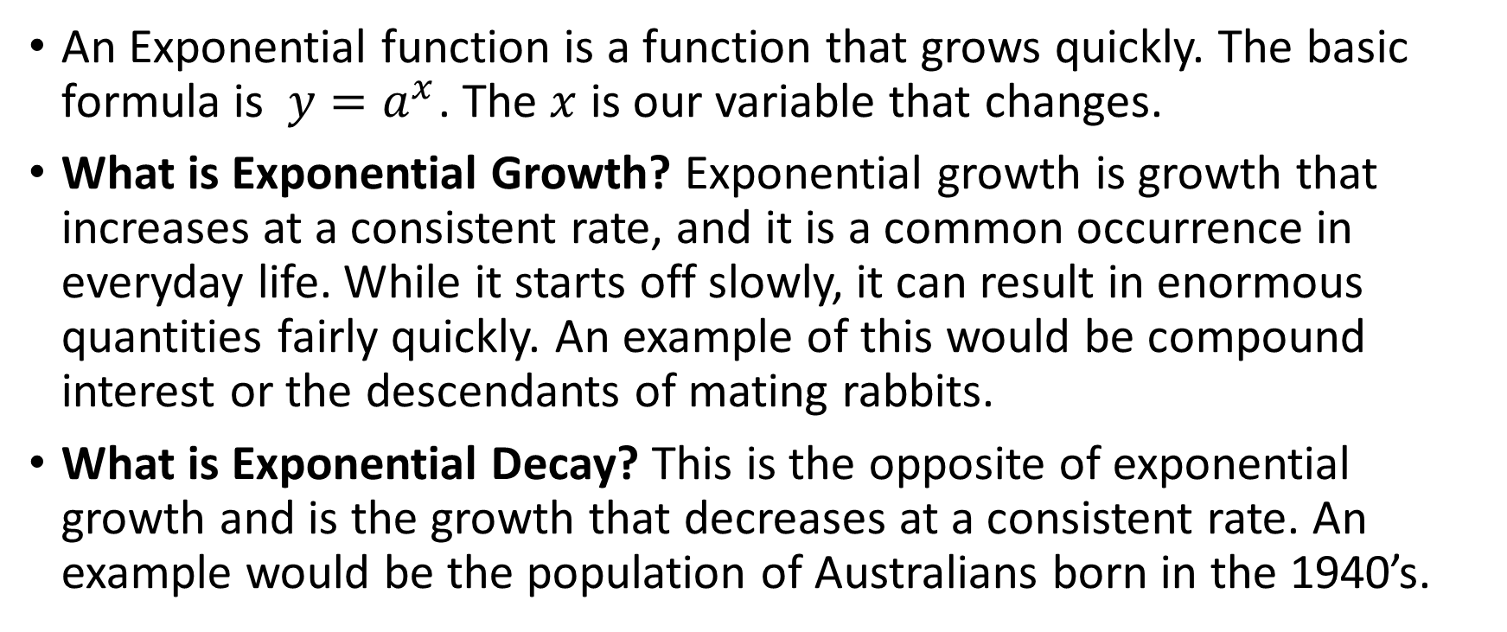
Exponential Functions EQ: How do I draw exponential Functions?
An Exponential function is a function that grows quickly. The basic formula is ${y=a}^{x}$. The $x$ is our variable that changes.
What is Exponential Growth? Exponential growth is growth that increases at a consistent rate, and it is a common occurrence in everyday life. While it starts off slowly, it can result in enormous quantities fairly quickly. An example of this would be compound interest or the descendants of mating rabbits.
What is Exponential Decay? This is the opposite of exponential growth and is the growth that decreases at a consistent rate. An example would be the population of Australians born in the 1940’s.

Slide 5
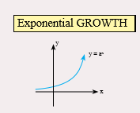

Exponential Growth and Decay.
Few important rules:
Exponential growth has a positive indices and Exponential decay has a negative indices.
As x gets smaller the line moves closer to the horizontal axis (x axis).
As x gets larger the graph becomes steeper.

Slide 6
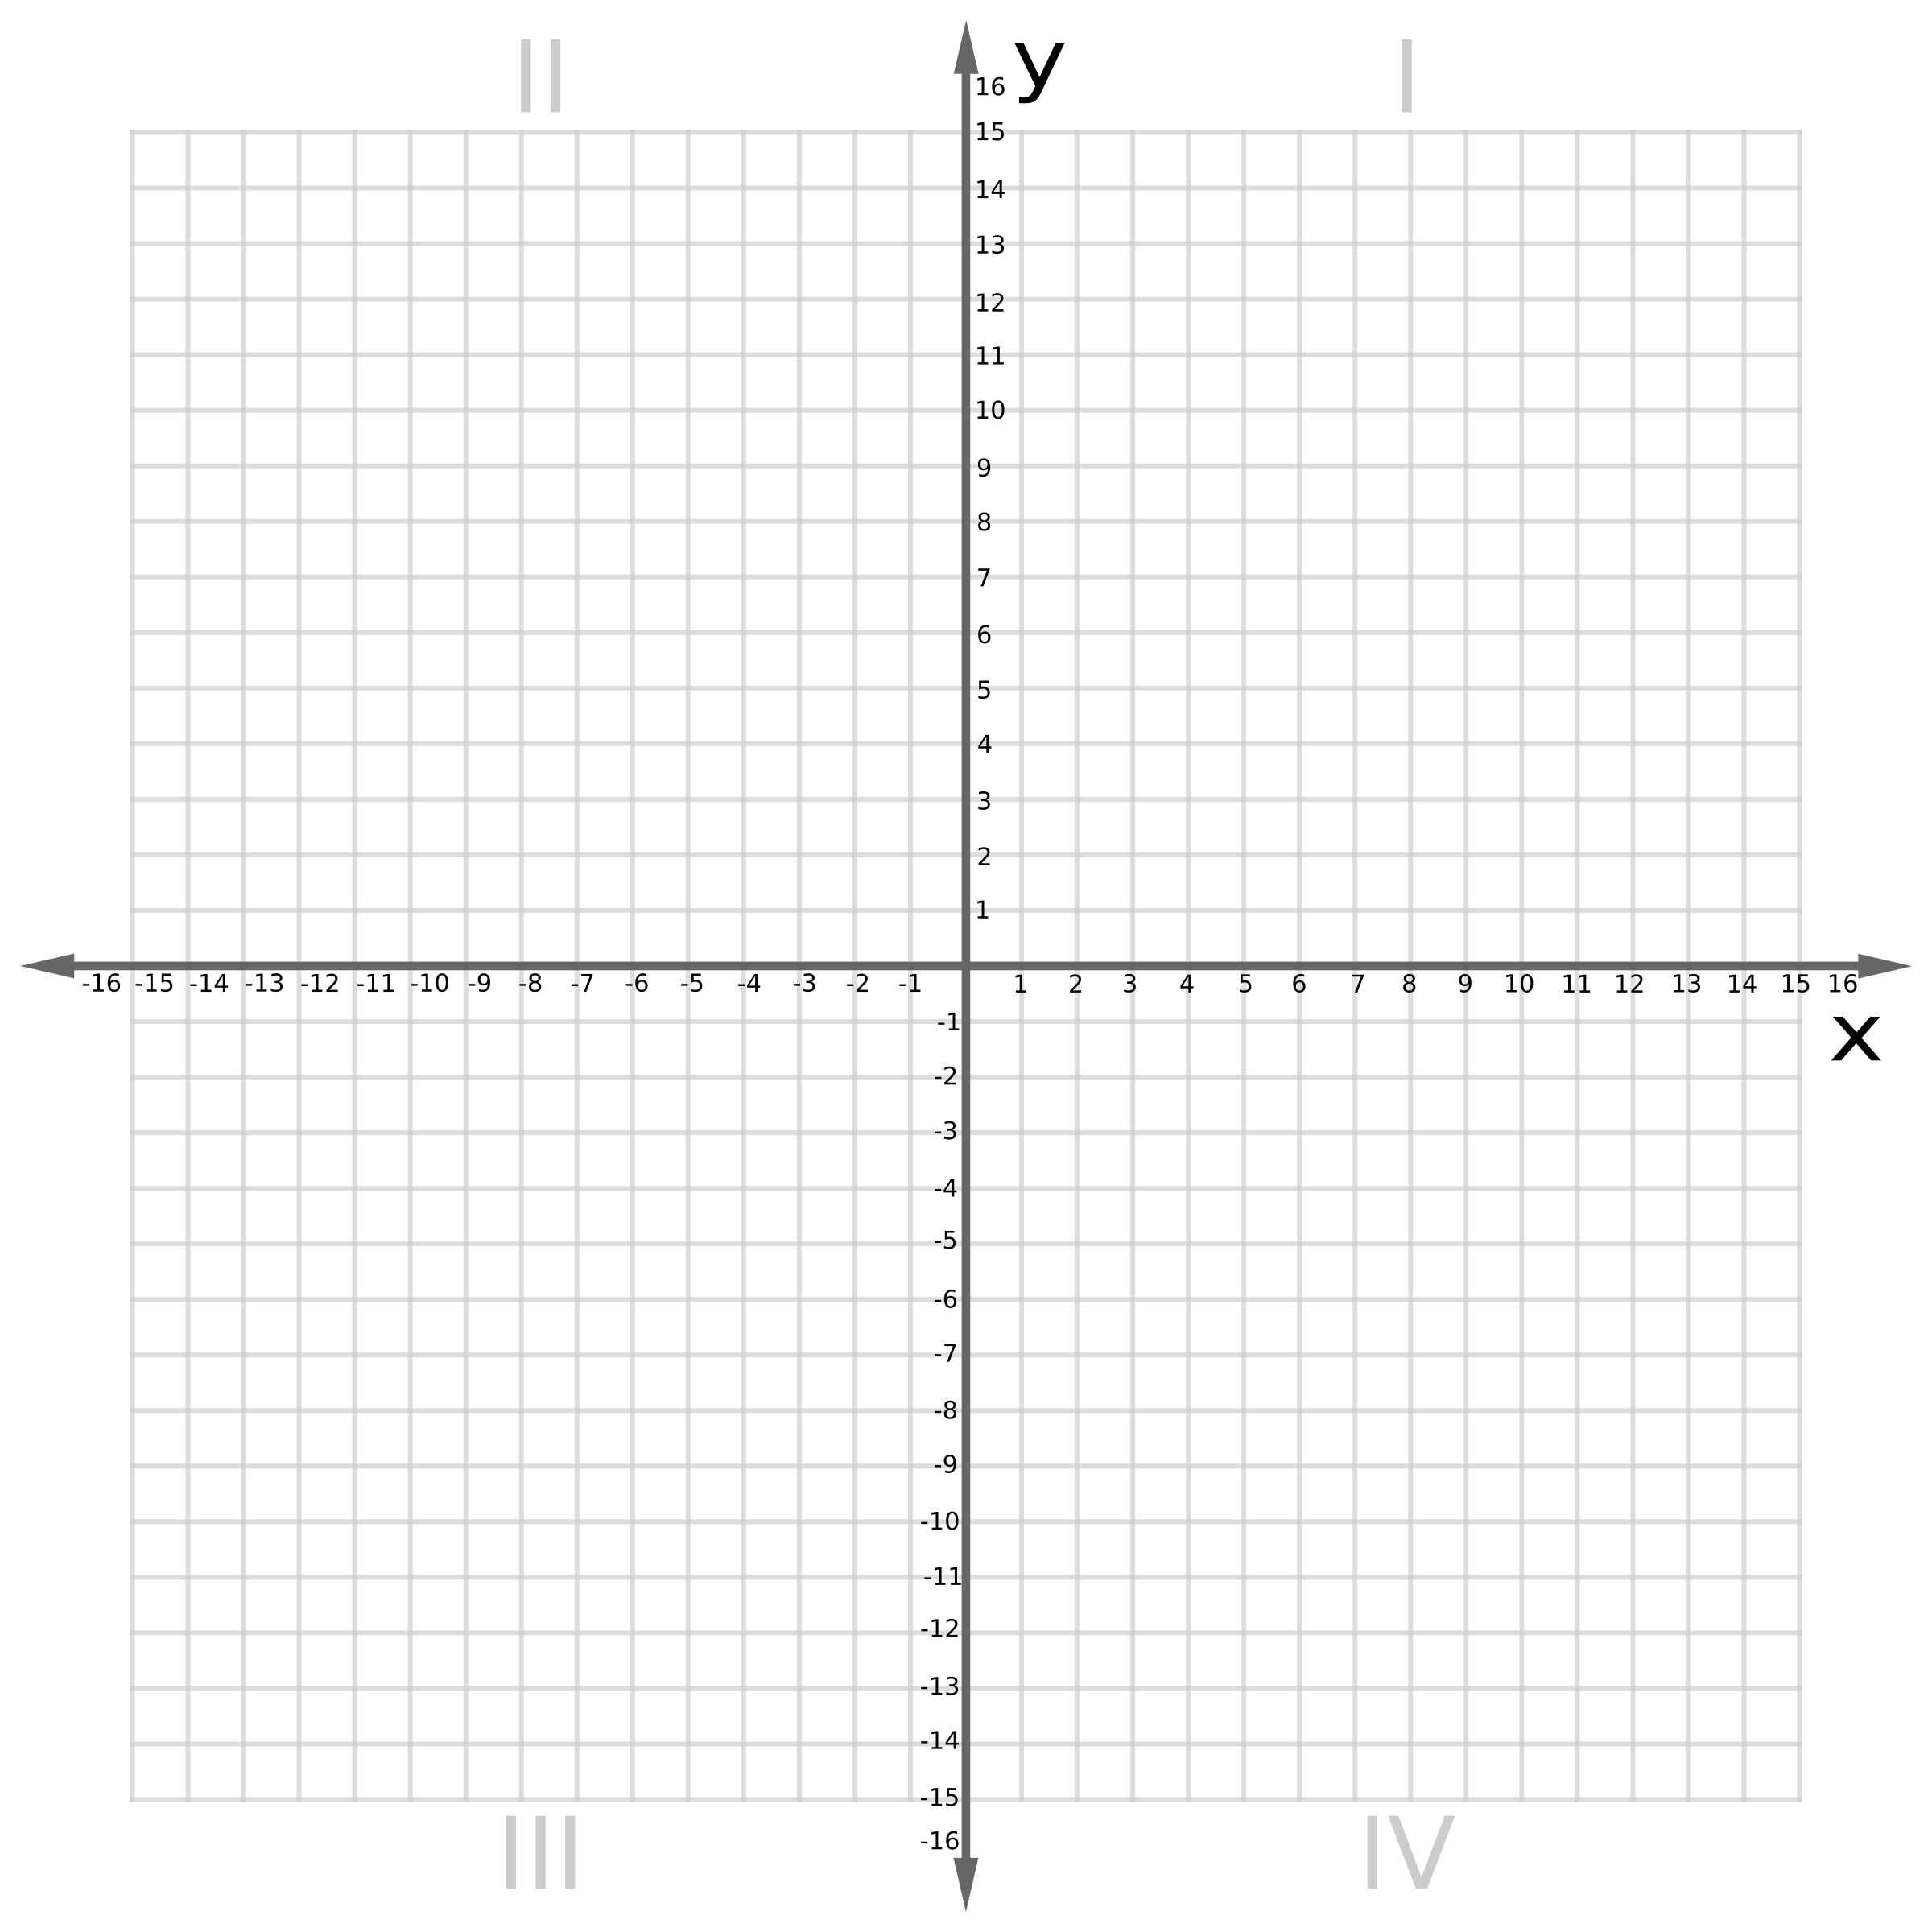

Example 1
$$y=2^{x}$$
x | -3 | -2 | -1 | 0 | 1 | 2 | 3
y

Slide 7

Example 2
$y=2^{x}$ $−5$
x | -3 | -2 | -1 | 0 | 1 | 2 | 3 | 4
y

Slide 8

Example 3
$$y =2^{x}$$
x | -3 | -2 | -1 | 0 | 1 | 2 | 3
y

Slide 9
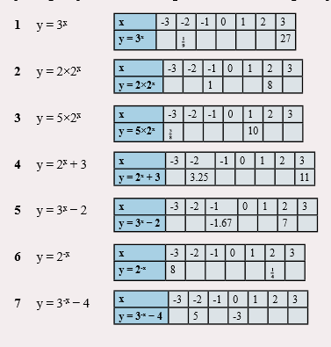
Practise Time
Complete the table of valves and graph

Slide 10
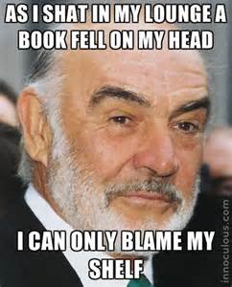

Thankyou and have great day.

